Slide 1
GOLDWASSER MICALI CRYPTOSYSTEM
Devyani Remulkar[2203110]
Harshini Maryada[2203118]

Slide 2
Contents
Preliminaries
GM Cryptosystem
Problems with GM
Generalized GM Cryptosystem
Our Experiments on Generalized GM

Slide 3
INTRODUCTION
Cryptology: The study of securing information and communication.
Includes Cryptography (building secure systems) which ensures that messages can be read only by intended parties.
Symmetric-Key/Private-Key Cryptography:
Uses same secret key for encryption and decryption which must remain a secret between the communicating parties.
Very fast and efficient
Both parties need the same secret key, but securely sharing that key is difficult without a public-key system.
Notes:
covering everything involved in making messages confidential and breaking the methods used to secure them.

Slide 4
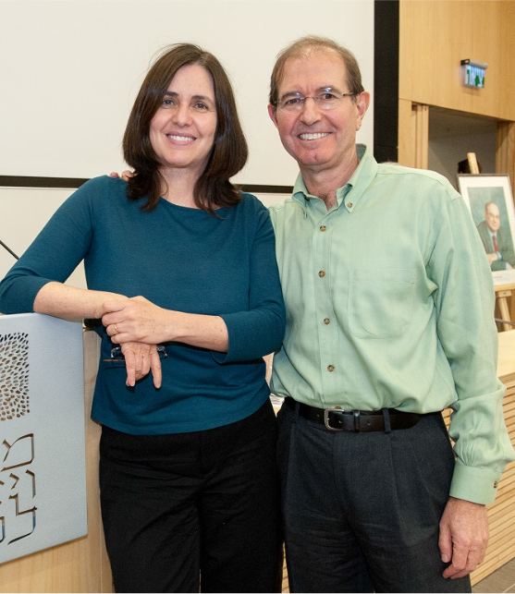
Introduction
Introduction to PKC
Public Key Cryptography (PKC) is a core cryptographic primitive.
Early PKC schemes like RSA were deterministic and vulnerable to CPA attacks.
Goldwasser–Micali Result
Shafi Goldwasser and Silvio Micali (1982) proposed the first probabilistic PKC.
It achieves semantic security, equivalent to IND-CPA.
Why Probabilistic Encryption?
IND-CPA security requires ciphertexts of different messages to be indistinguishable.
This indistinguishability is only achievable using randomized (probabilistic) encryption.
The GM scheme was the first IND-CPA secure PKC, relying on the quadratic residuosity assumption.
Notes:
Indistinguishability under Chosen-Plaintext Attack.
It is the standard security requirement for modern encryption schemes.
An encryption scheme is IND-CPA secure if Even when an attacker can choose plaintexts and see their encryptions,They cannot distinguish which plaintext corresponds to a given ciphertext,
Beyond random guessing
Deterministic: same message → same ciphertext → CPA-vulnerable
Probabilistic: adds randomness → different ciphertexts → required for IND-CPA
GM is the first probabilistic and first IND-CPA secure PKC

Slide 5
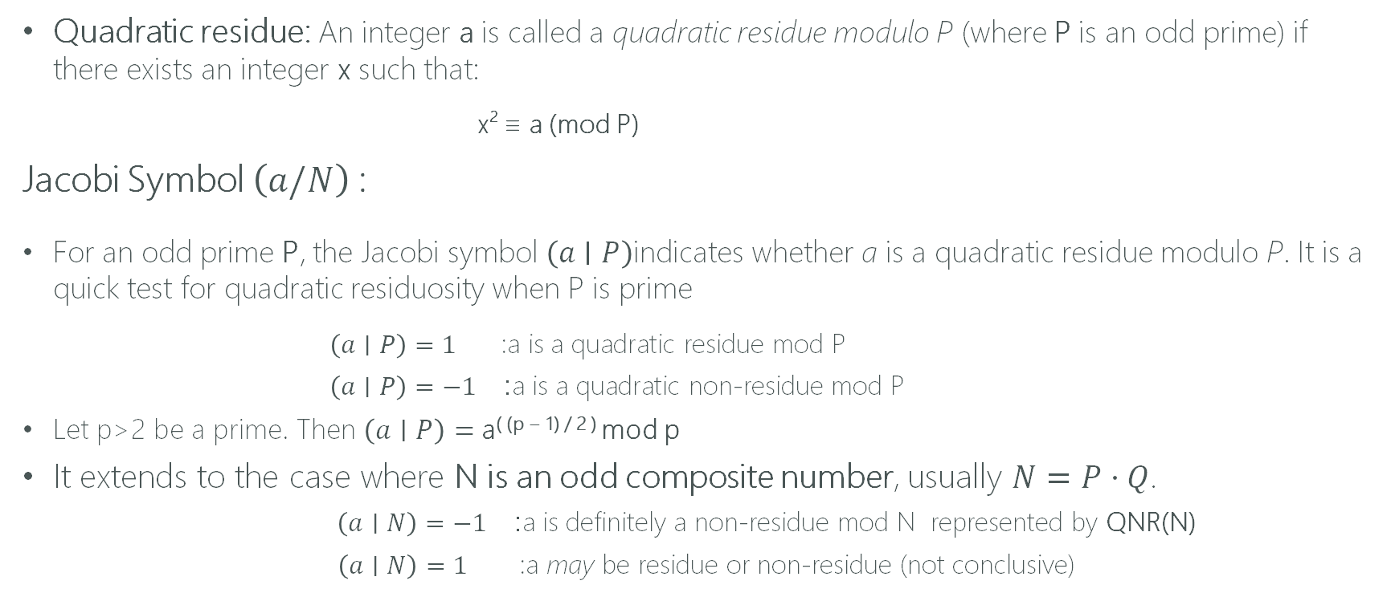
Preliminaries
Quadratic residue: An integer a is called a quadratic residue modulo P (where P is an odd prime) if there exists an integer x such that:
x² ≡ a (mod P)
Jacobi Symbol $\left(a/N\right)$:
For an odd prime P, the Jacobi symbol $\left(a∣P\right)$indicates whether a is a quadratic residue modulo P. It is a quick test for quadratic residuosity when P is prime
$\left(a∣P\right)=1$ :a is a quadratic residue mod P
$\left(a∣P\right)=−1$: a is a quadratic non-residue mod P
Let p>2 be a prime. Then $\left(a∣P\right)=$a^{( (p − 1) / 2 )} mod p
It extends to the case where N is an odd composite number, usually $N=P⋅Q$.
$\left(a∣N\right)=−1$: a is definitely a non-residue mod N represented by QNR(N)
$\left(a∣N\right)=1$ :a may be residue or non-residue (not conclusive)

Slide 6
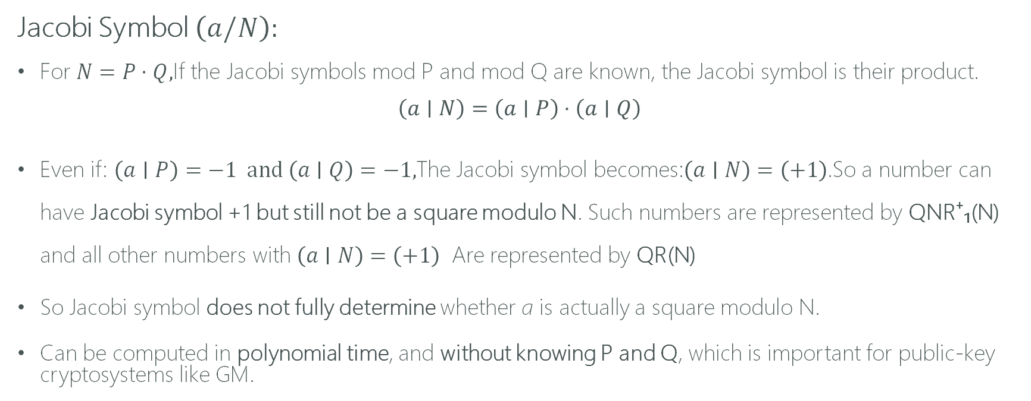
Preliminaries
Jacobi Symbol $\left(a/N\right):$
For $N=P⋅Q,$If the Jacobi symbols mod P and mod Q are known, the Jacobi symbol is their product.
$$\left(a∣N\right)=\left(a∣P\right)⋅\left(a∣Q\right)$$
Even if: $\left(a∣P\right)=−1 and \left(a∣Q\right)=−1,$The Jacobi symbol becomes:$\left(a∣N\right)=\left(+1\right)$.So a number can have Jacobi symbol +1 but still not be a square modulo N. Such numbers are represented by QNR⁺₁(N) and all other numbers with $\left(a∣N\right)=\left(+1\right)$ Are represented by QR(N)
So Jacobi symbol does not fully determine whether a is actually a square modulo N.
Can be computed in polynomial time, and without knowing P and Q, which is important for public-key cryptosystems like GM.

Slide 7
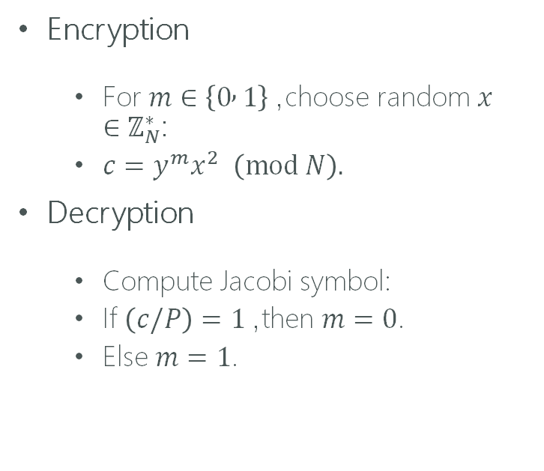
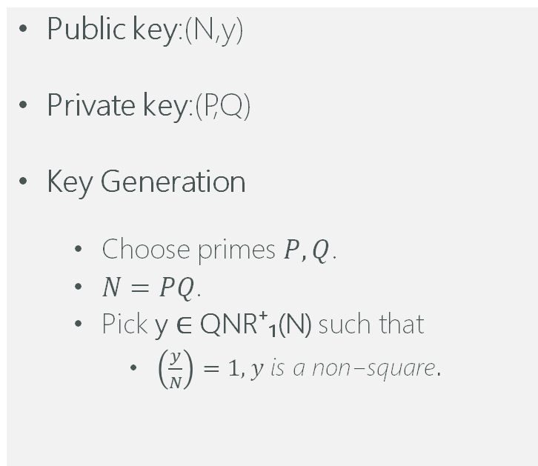
GM Cryptosystem
Public key:(N,y)
Private key:(P,Q)
Key Generation
Choose primes $P,Q$.
$N=PQ$.
Pick y ∈ QNR⁺₁(N) such that
$\left(\frac{y}{N}\right)=1, y \text{is} \text{a} \text{non}\text{−}\text{square}.$
Encryption
For $m∈\left\{0 , 1\right\}$, choose random $x∈ℤ_{N}^{∗}$:
$c=y^{m}x^{2} \left(mod N\right).$
Decryption
Compute Jacobi symbol:
If $\left(c/P\right)=1$, then $m=0$.
Else $m=1$.

Slide 8
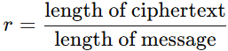
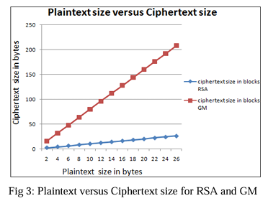
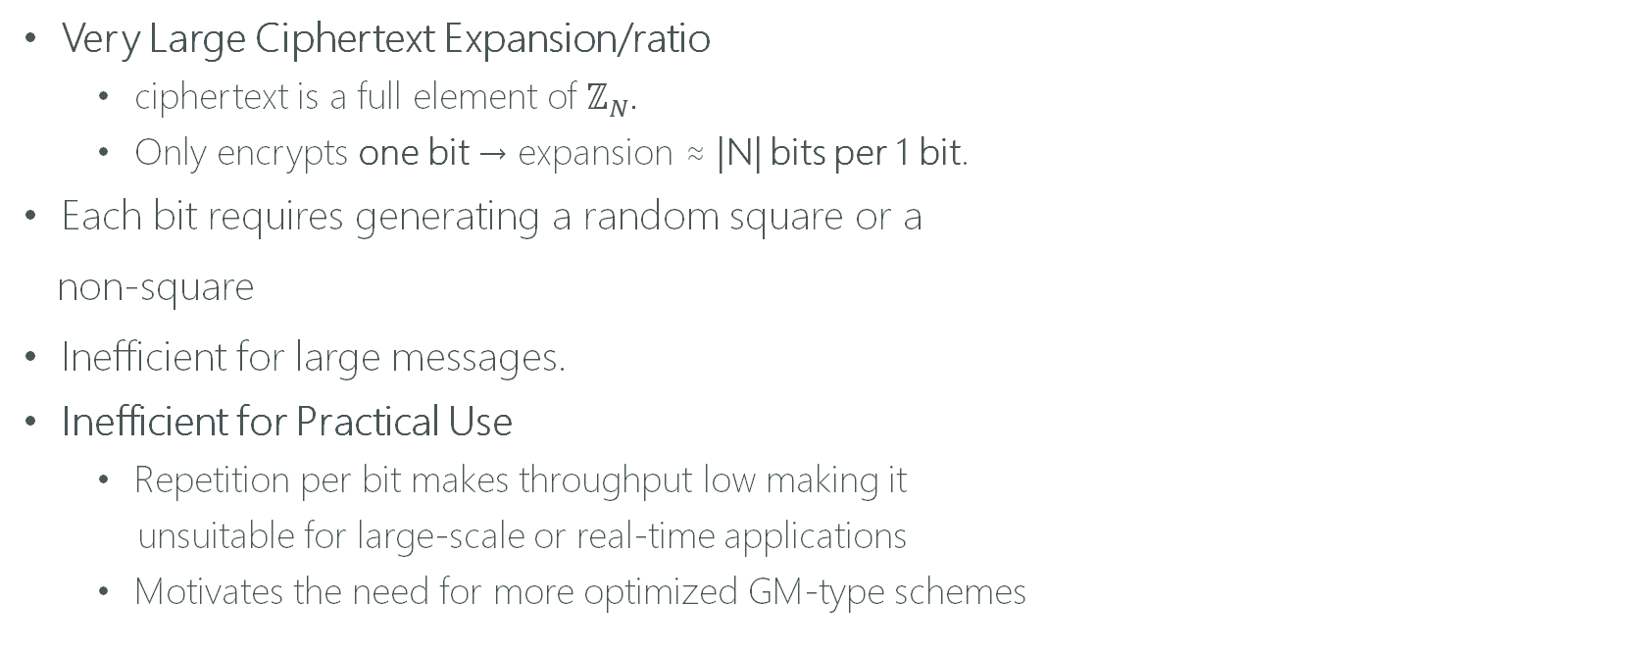
Problems with GM
Very Large Ciphertext Expansion/ratio
ciphertext is a full element of $ℤ_{N}$.
Only encrypts one bit → expansion ≈ |N| bits per 1 bit.
Each bit requires generating a random square or a
non-square
Inefficient for large messages.
Inefficient for Practical Use
Repetition per bit makes throughput low making it
unsuitable for large-scale or real-time applications
Motivates the need for more optimized GM-type schemes

Slide 9

Generalized GM cryptosystem

Slide 10
Introduction
An extended version of the classic GM encryption scheme proposed by Ying Guo, Xiao-Lei Dong, and Zhen-Fu Cao in their 2022 paper “Generalized Goldwasser and Micali’s Type Cryptosystem”, published in Journal of Computer Science and Technology.
Supports multi-bit encryption instead of only 1 bit per ciphertext.
Uses a modulus of the form N= Pª Q^{b} to encode larger message blocks where P & Q are distinct primes and a,b are natural numbers.
It consists of 3 parts
Key generation
Encryption
Decryption

Slide 11
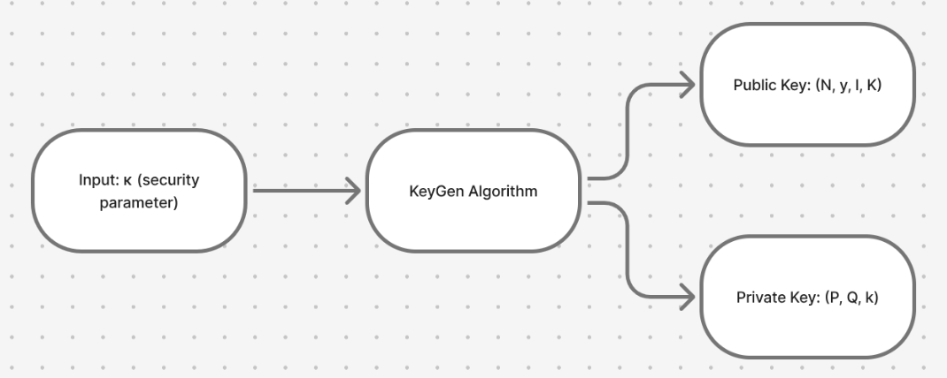
KEY GENERATION
The Key-gen algorithm takes kappa,a,b as input which determines the size of primes to be used and generates the public and private key.
Public key = (N,y,l,K)
Private Key = (P,Q,k)

Slide 12
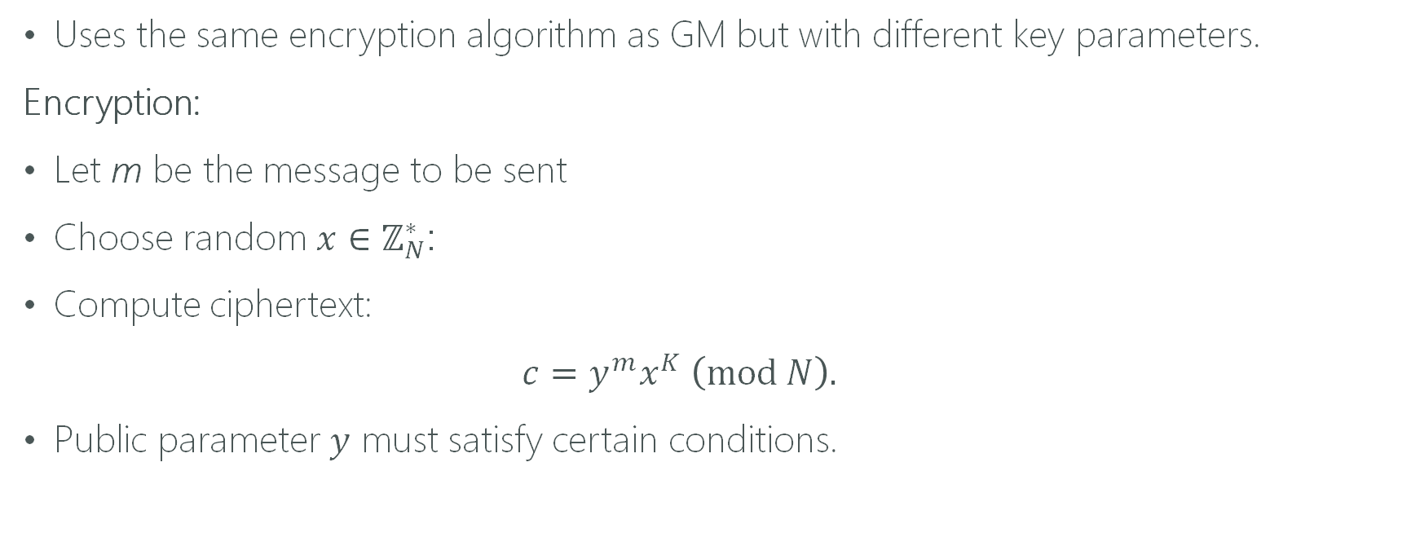
Encryption
Uses the same encryption algorithm as GM but with different key parameters.
Encryption:
Let m be the message to be sent
Choose random $x∈ℤ_{N}^{∗}$:
Compute ciphertext:
$c=y^{m}x^{K} \left(mod N\right).$
Public parameter $y$ must satisfy certain conditions.

Slide 13
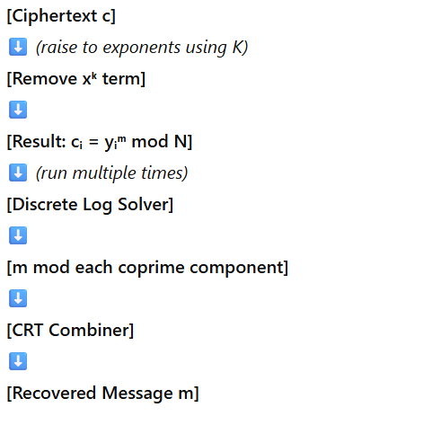
Decryption
DECRYPTION FLOW ->
Decryption Algorithm
First we remove x^{K} by raising both sides to appropriate exponents and using the properties of K.
Then we pass the resultant c_{i} = y_{i}^{m} mod N to Discrete Log algorithm several times and it computes m modulus different relatively prime components.
Then finally we use Chinese Remainder Theorem to combine them to get our original message m.

Slide 14
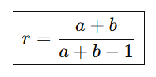
Ciphertext Expansion r of Generalized GM-Type Scheme
The ciphertext expansion of this scheme turns out to be -
where:
a = exponent of prime P
b = exponent of prime Q

Slide 15

OBSERVATIONS FROM OUR EXPERIMENTS ON GENERALIZED GM

Slide 16
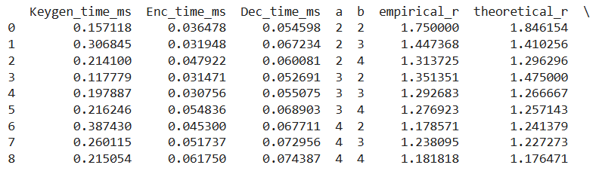
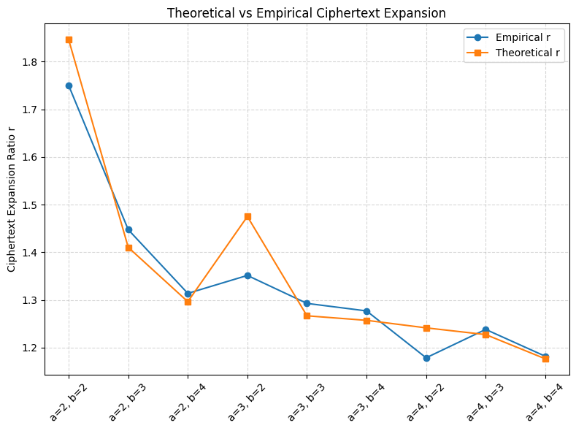
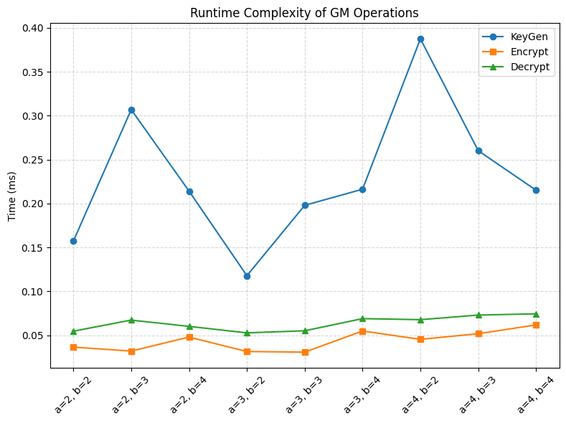

Slide 17
References
Guo, Cao, Dong — Generalized Goldwasser and Micali’s Type Cryptosystem (2022). https://link.springer.com/article/10.1007/s11390-021-0806-1
J. Katz, Y. Lindell — Introduction to Modern Cryptography, Chap. 11
https://pages.cs.wisc.edu/~shruthir/Documents/PerformanceAnalysisOfGoldwasserMicaliCryptosystem.pdf
https://www.researchgate.net/publication/391677127_Efficient_Lifting_of_Discrete_Logarithms_Modulo_Prime_Powers

Slide 18
THANK YOU

